Slide 1
Zomato’s API: What’s on the Menu in Denver?
Chad Anderson, Damian McDonald, Laura Talkington, Jack Heston

Slide 2

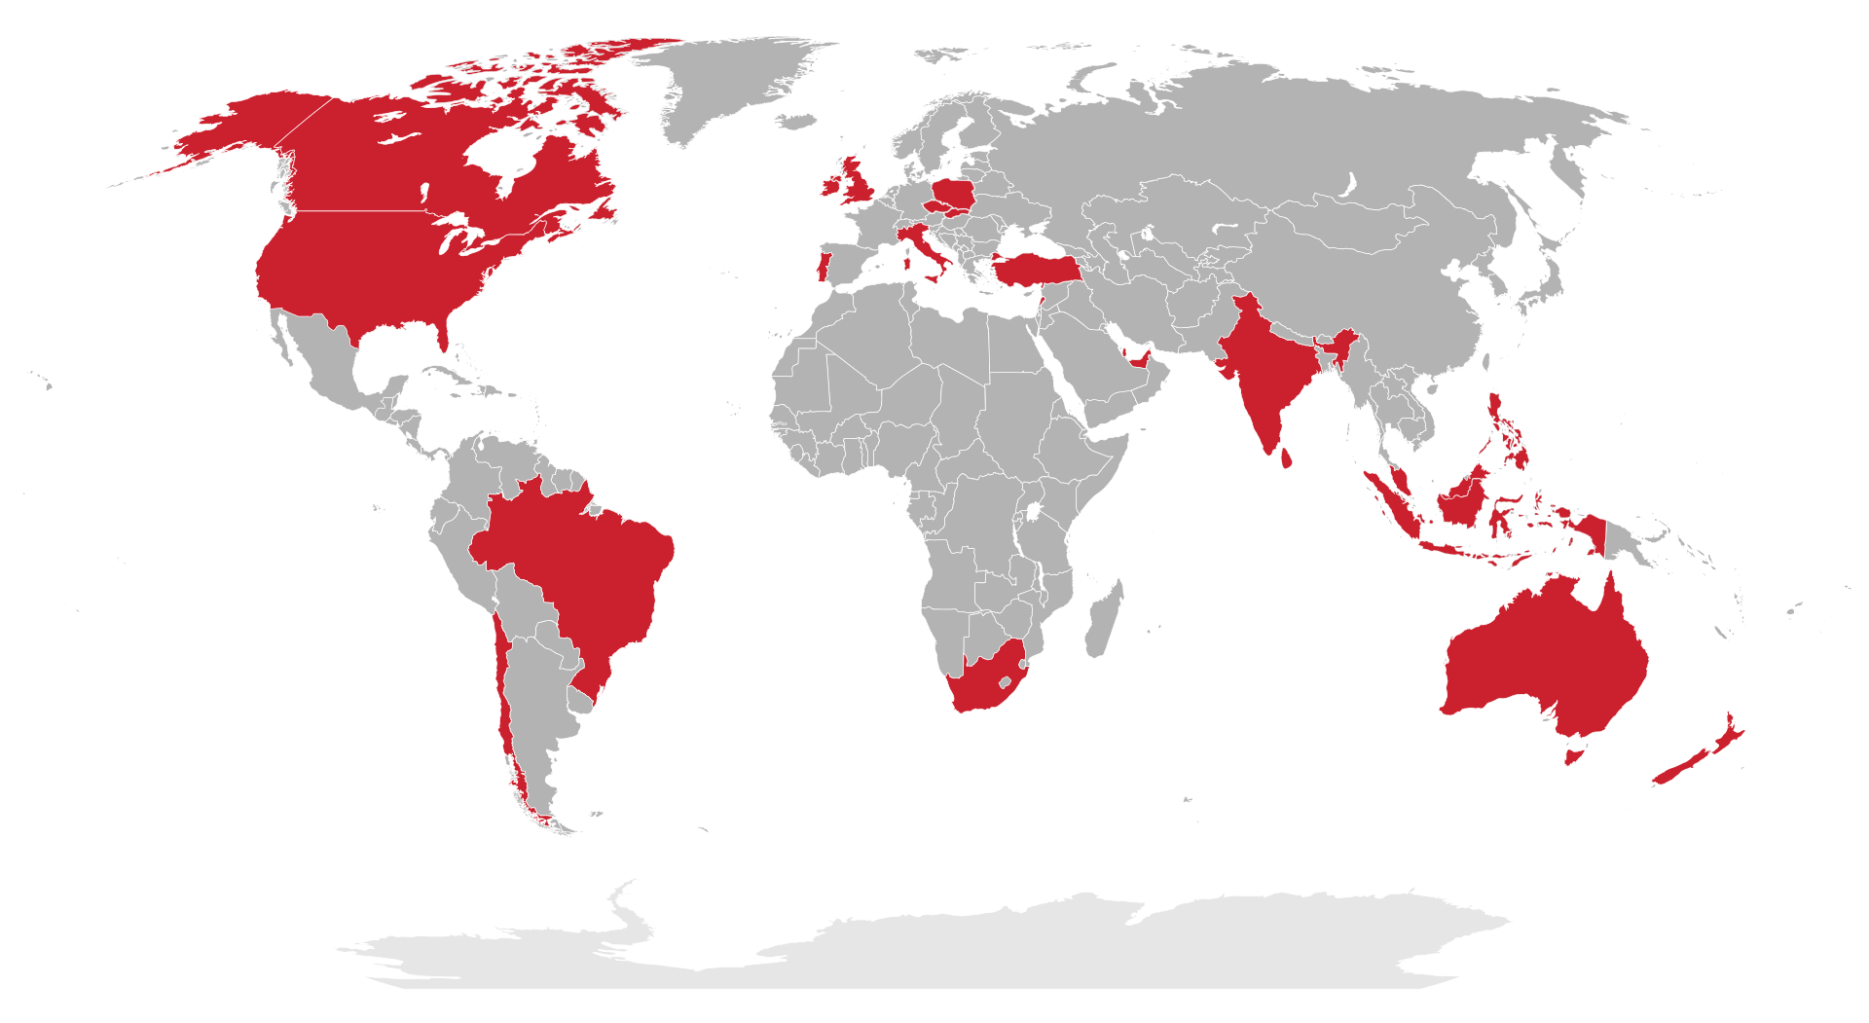
Notes:
Zomato is an Indian restaurant search and discovery service. It currently operates in 24 countries and provides information and reviews on restaurants, including images of menus where the restaurant does not have its own website.

Slide 3
Core Message:
Identify the top restaurants in Denver through Zomato ratings by users
Identify the top restaurants in Denver through Zomato through 5 different cuisine types
Determine the locations of the top rated restaurants in Denver
Scatterplot & heatmaps
What kind of restaurants were the most popular around Denver?
Where are these restaurants mainly located?
What is the distribution of the top 100?
Zomato API was used based on the general search API which used latitude and longitude, then cuisine ID which was identified by the group

Slide 4
API key limited to 100 results
API key limited to 100 requests per day
API seems restrictive in general and convoluted
Multiple API’s needed to get our identified data
API keys were difficult to determine how to get the data we wanted
Parsing down cuisine types as there were multiple descriptors for each restaurant
Moved the full 500 into a CSV for simplified parsing
Trial and error mostly
Parsing down to create multiple columns of cuisine types
Determining which API’s were the correct ones to find our data
Most of the top restaurants are located around downtown Denver
Highest density around LoDo, Cherry Creek, Highlands, Cap Hill, Baker,
Smaller pockets in Lakewood, Edgewater, Boulder, Englewood, University of Denver

Slide 5

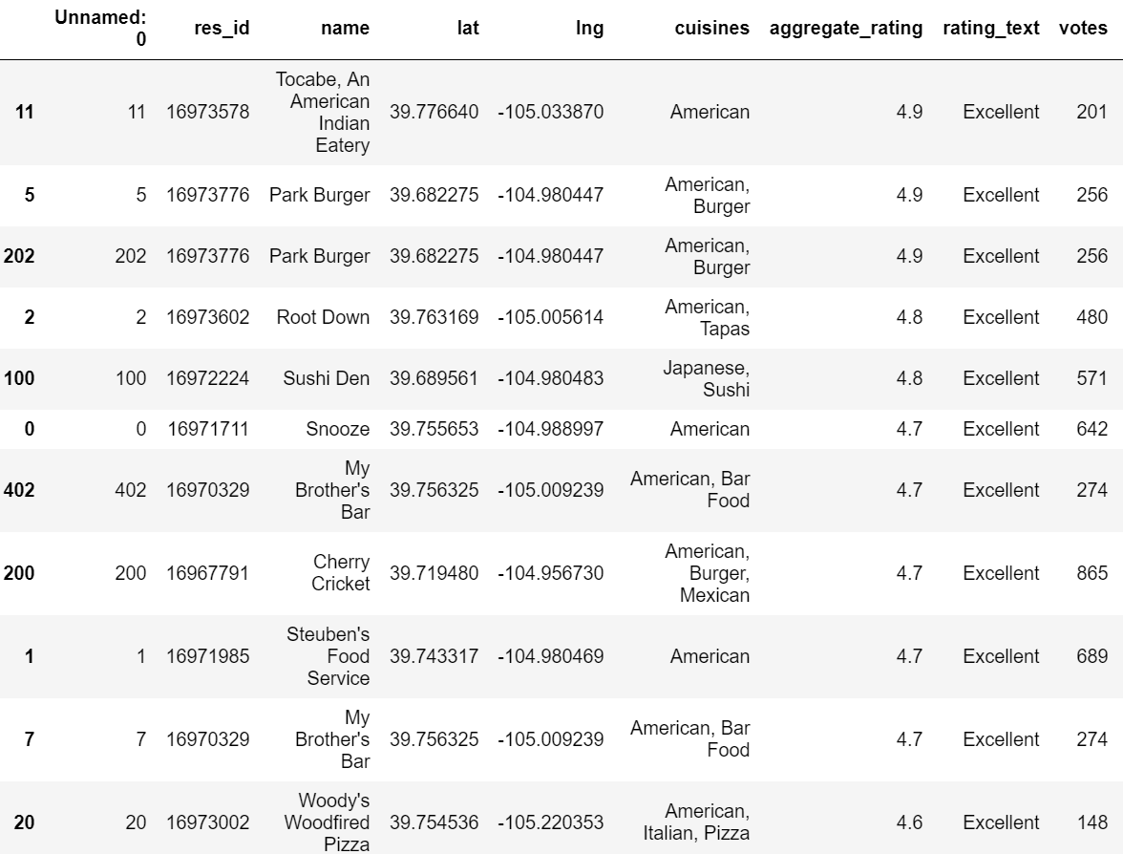

Slide 6
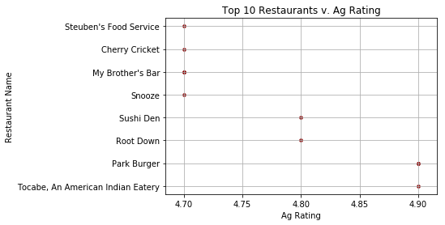
Top 10 Cuisines Overall

Slide 7

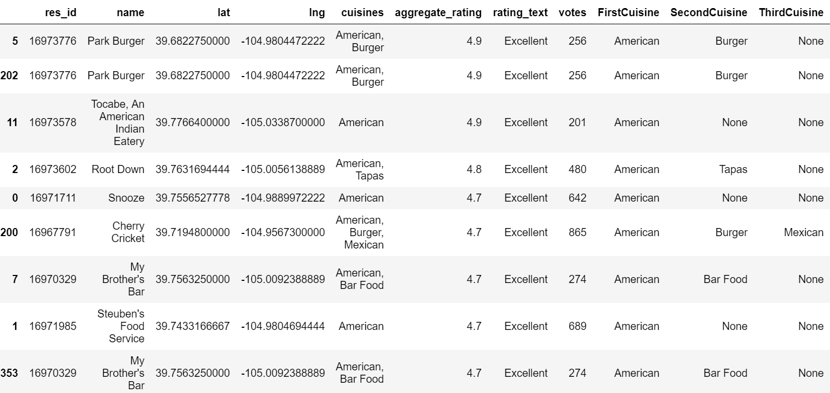
Top 8 American Cuisine

Slide 8
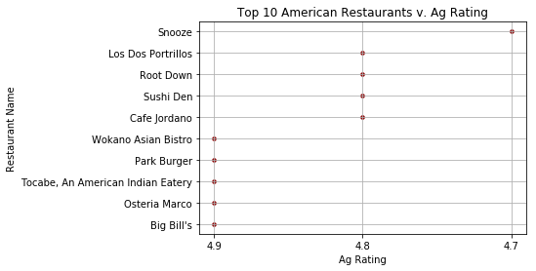
Top 10 American Cuisine v/ Aggregate Rating

Slide 9
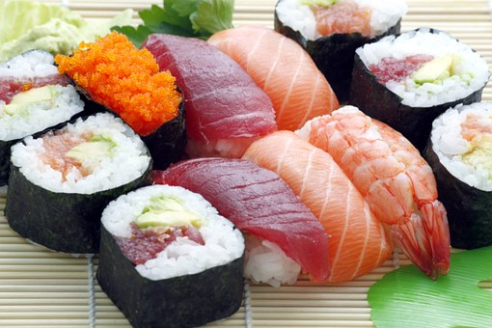
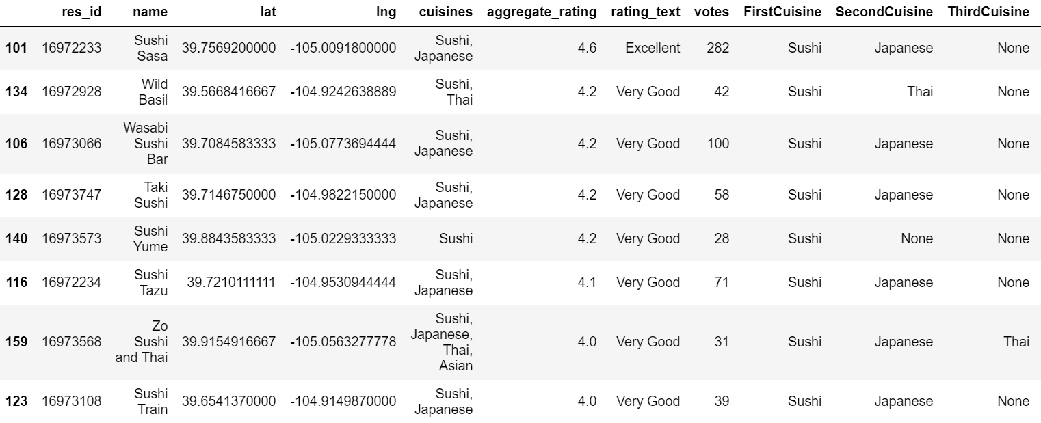
Top 8 Sushi

Slide 10
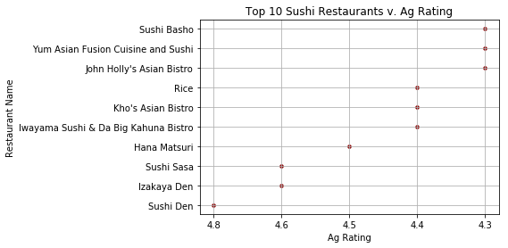
Top 10 Sushi Cuisine v/ Aggregate Rating

Slide 11
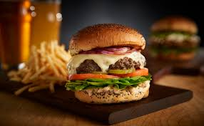
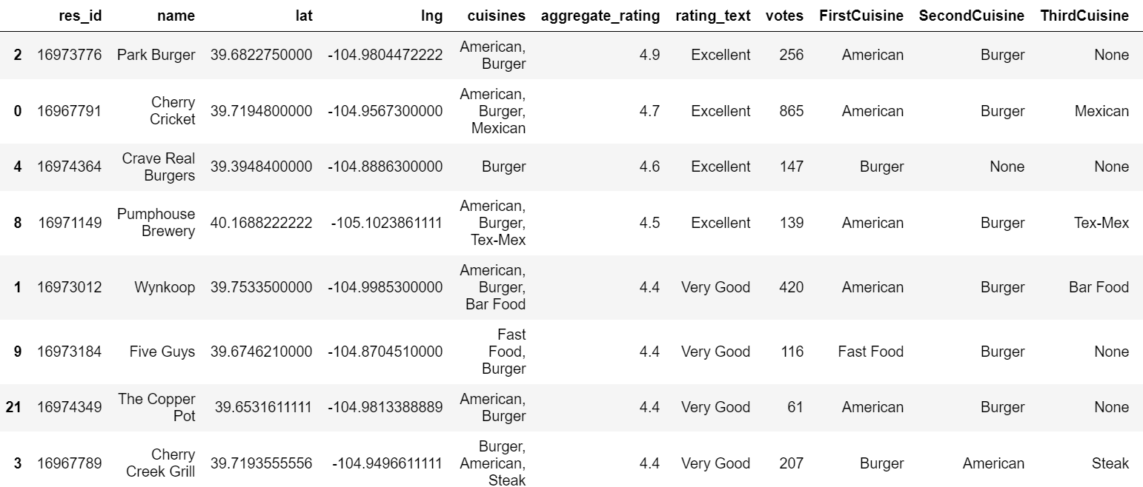
Top 8 Burger Joints

Slide 12
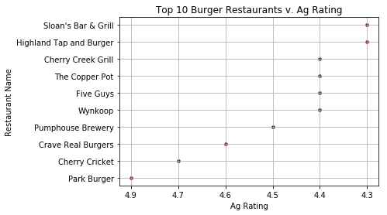
Top 10 Burger Cuisine v/ Aggregate Rating

Slide 13
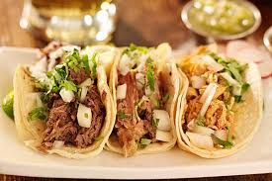
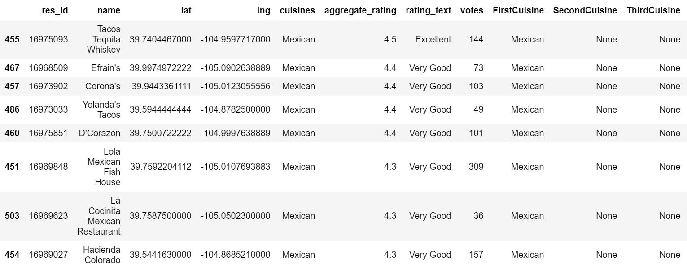
Top 8 Mexican

Slide 14
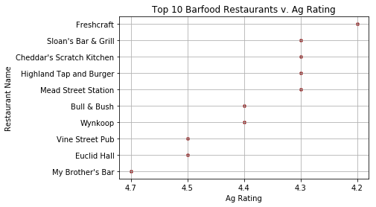
Top 10 Bar Food Cuisine v/ Aggregate Rating

Slide 15
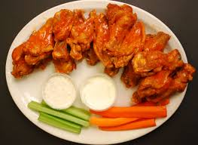
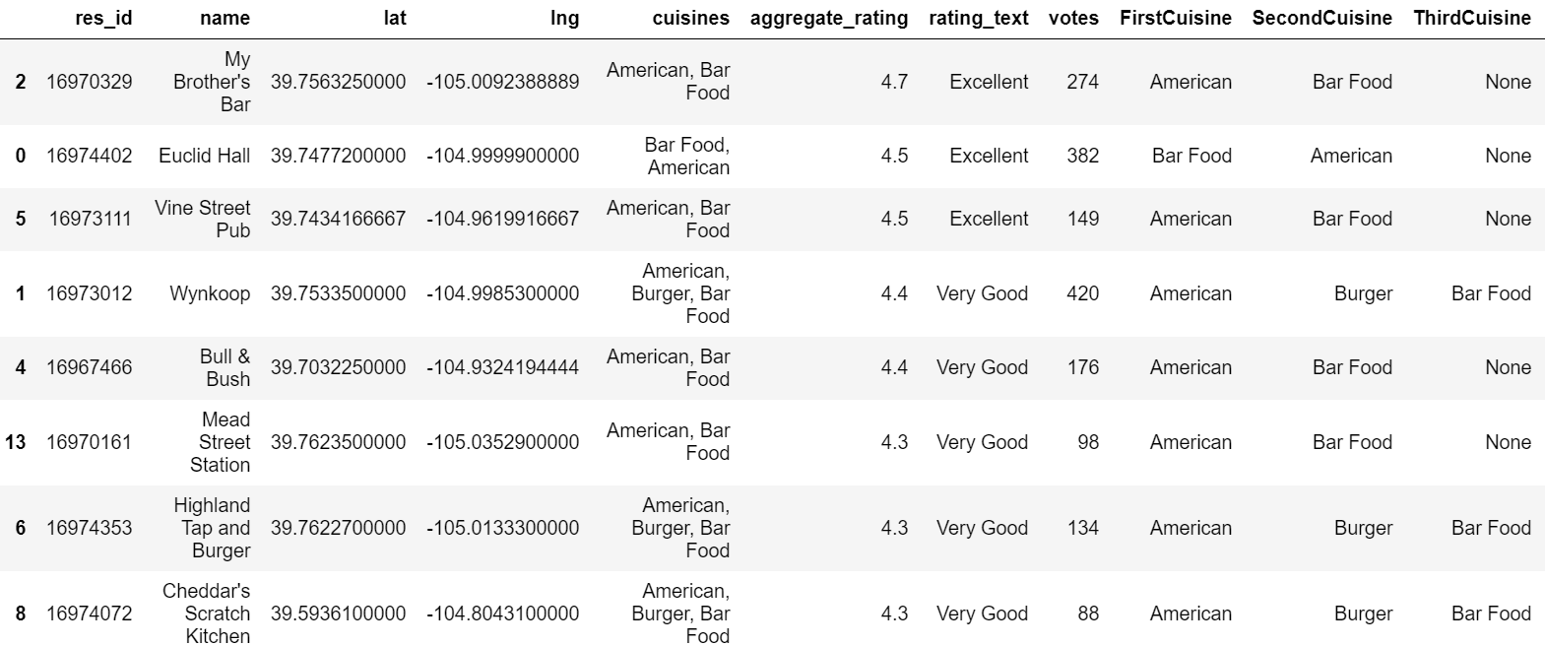
Top 8 Bar Food

Slide 16
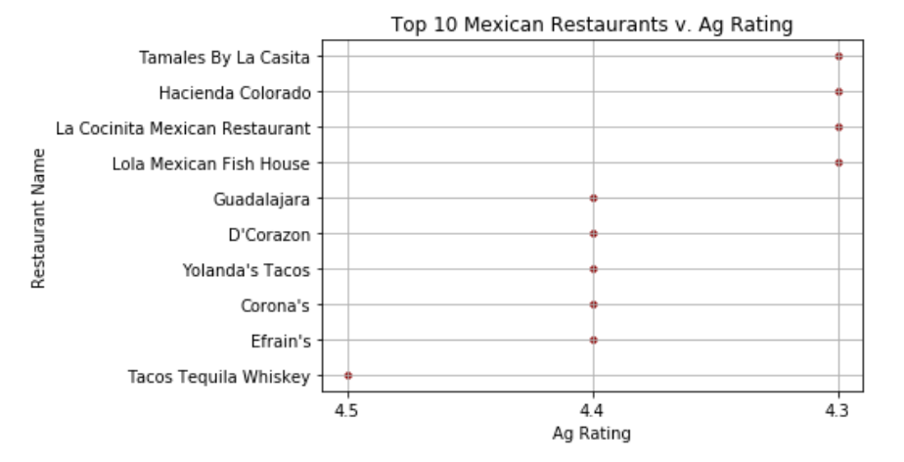
Top 10 Mexican Cuisine v/ Aggregate Rating

Slide 17
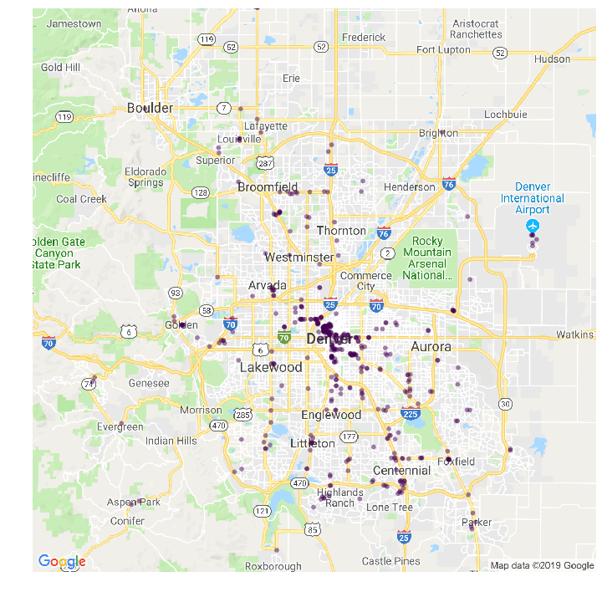
Notes:
The location of the establishments we analyzed

Slide 18
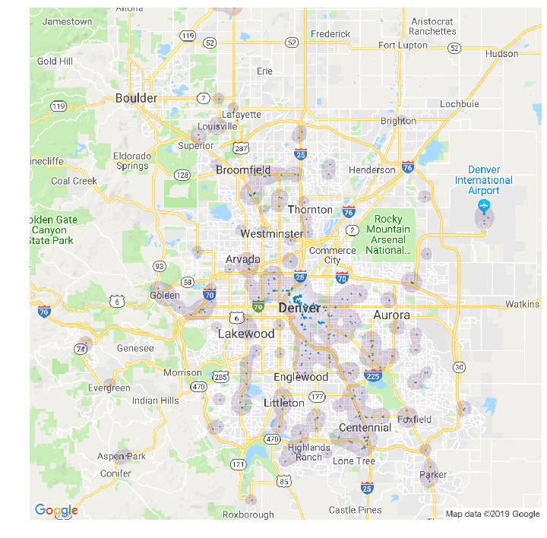

Slide 19
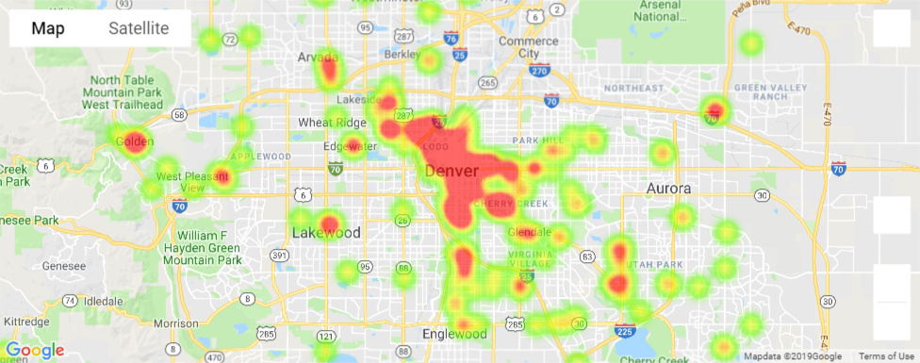
Notes:
The highest concentration of these establishments is, no secret, in central Denver.

